Slide 1

Group 14 Vikings vs Spartans
Level 4/5 Group 14: Ethan Ward, Mircea Lazar, Petrut Vasile, Toby White

Slide 2
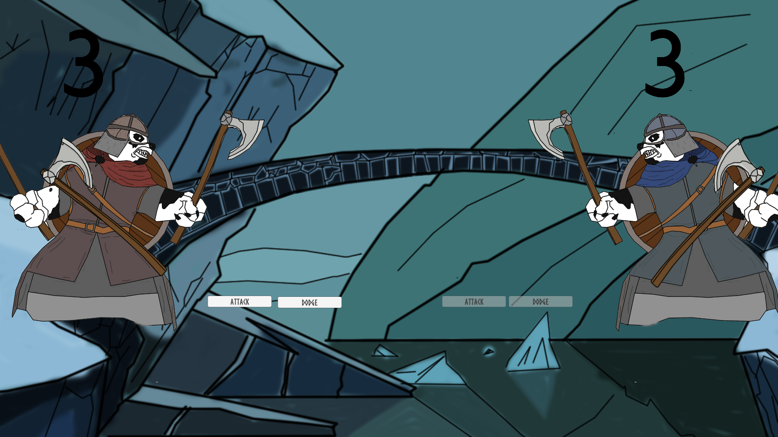
How the game fits the brief
E
Symmetrical 2D
turn based multiplayer game
played on a single mobile device
controlled by tapping
Notes:
The Assignment
2D Game
Main control mechanic is a simple tap
Multiplayer – by taking turns
On a single device
Symmetric
Simple and intuitive rules
The gameplay experience should be
Engaging
Focused
Polished
Why mobile?
Growing at a phenomenal pace
Why tap?
Casual Users don’t have years of gaming experience
Casual Users don’t have the dexterity of gamers
Casual Users play on their phone to pass time
So everyone can play the game
Supports all kinds of users
Easy to control and understand but difficult to master!
Why multiplayer?
The competitive nature of the game makes it easy for users to commit to it giving your game a higher retention than single player games.
It creates a feeling of urgency as both players progress through gameplay and approach the “finish line”.
Opponents are also a strong tool in making an experience that is always fresh.

Slide 3
Target audience
E
Core audience
Casual mobile gamers
Ages between
14 - 35
Male

Slide 4
How we iterated based on feedback
M
We now have a theme and artwork to go along with it
Changed our idea
Notes:
No theme
Generic
Why would they play the game
Mechanics are in other games

Slide 5
The player experience & emotions
M
Desired emotions:
Joy, Fear.
Relief, Nervousness.
We aim for:
People Fun.
Hard Fun.
Schadenfreude.
Fiero.
Notes:
On the side of the player experience, we aim for the primary emotions of Fear and Joy (joy for hitting and fear of the enemy hitting). The secondary emotions we target are the Relief and Nervousness, linked to the primary emotion of Fear.
Being a 2 player game, our first goal is to achieve a sense of people fun. This comes packaged with the emotion of schadenfreude
Having a twitch mechanic as out main game mechanic, we are of course expecting a sense of hard fun, bringing with it the emotion of Fiero.

Slide 6
What are the games challenges?
M
Social
Strategical
Physical challenge
Twitch mechanic

Slide 7
Mechanics:
P
Attack
Dodge
Pendulum

Slide 8
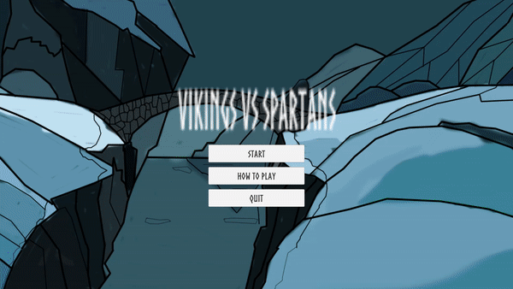
What does the player do?
P
Notes:
Thinking about removing the buttons in the main level as it is just another step for the player

Slide 9
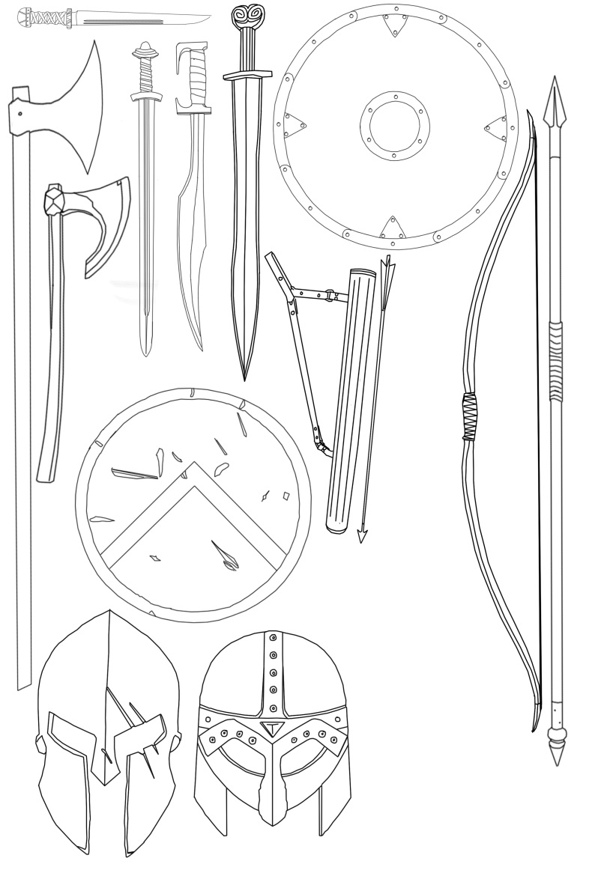
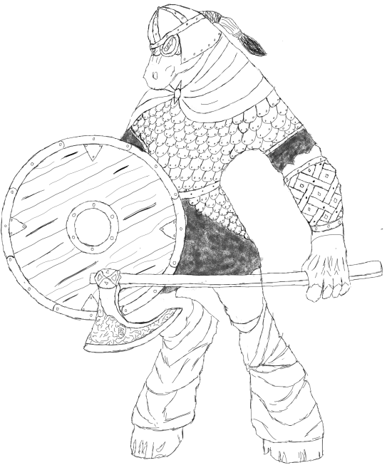
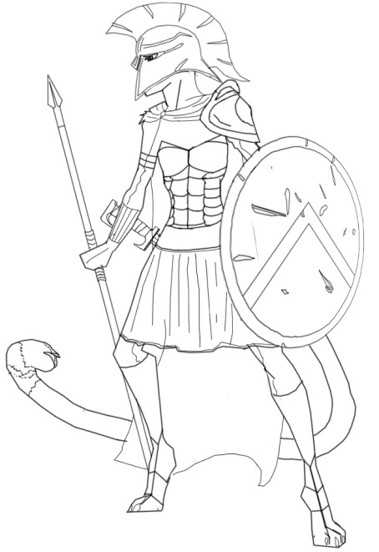
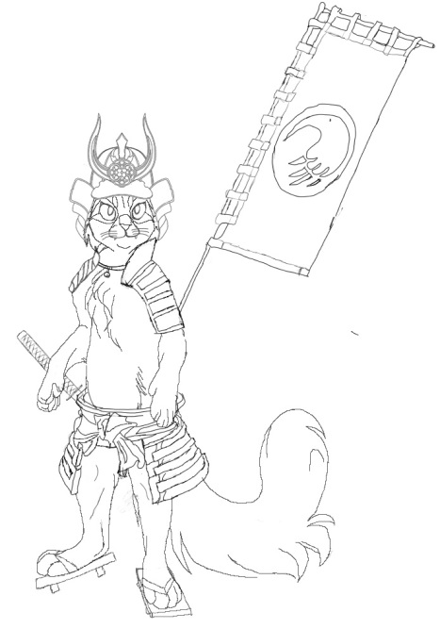
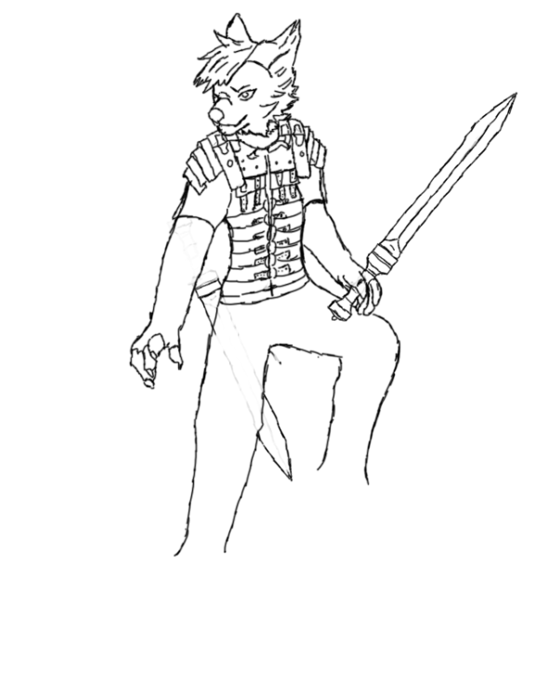
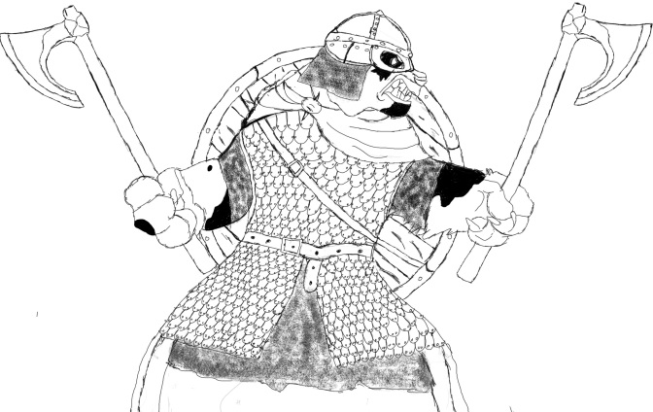
Concept Art
M&T
Anthropomorphized Animals
Warrior
Cultures
Notes:
We started out concept art development by combining the 2 major factors of the theme: Anthropomorphized Animals and Warrior Cultures. We iterated a bit based on the survey and on suggestions from the team, until we found the 2 final combinations: Ursine Vikings vs Feline Spartans (in our example, Panda vs Cats). The Next step was in preparing a library of possible items and motifs that we would use in our work. This Library that was appropriately dubbed “The Armory” served in providin a constant art style in the creation of the game assets.

Slide 10
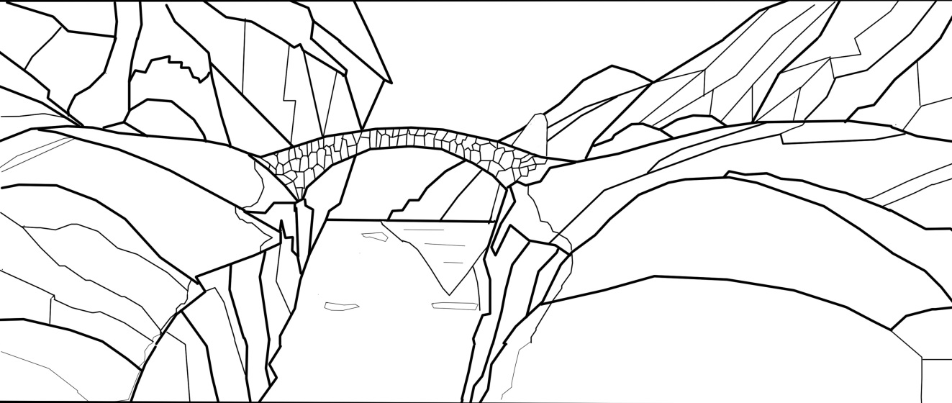
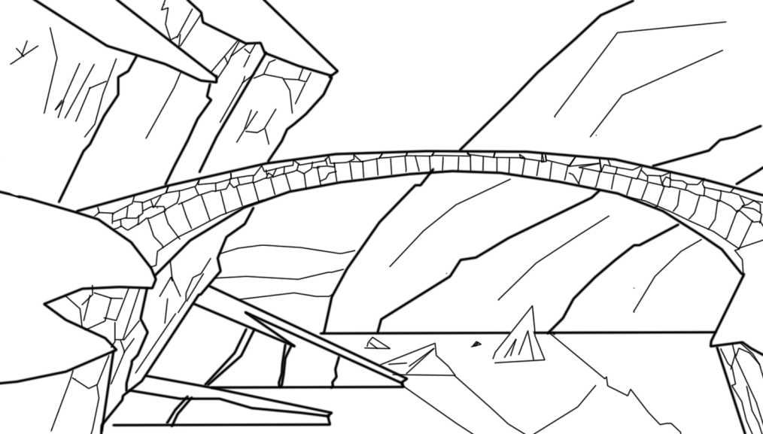
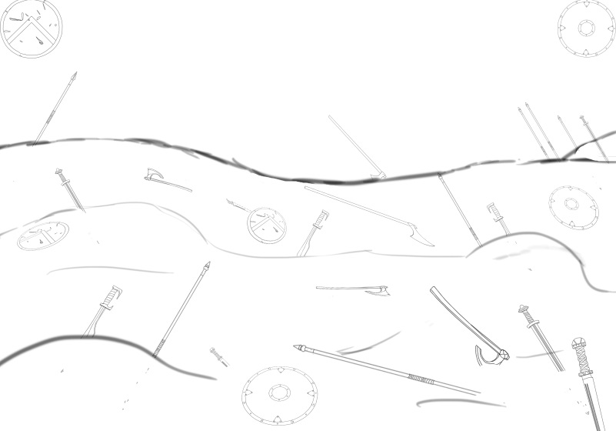
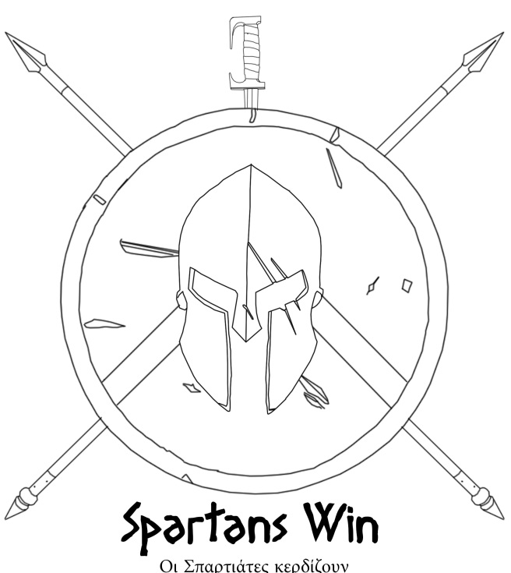
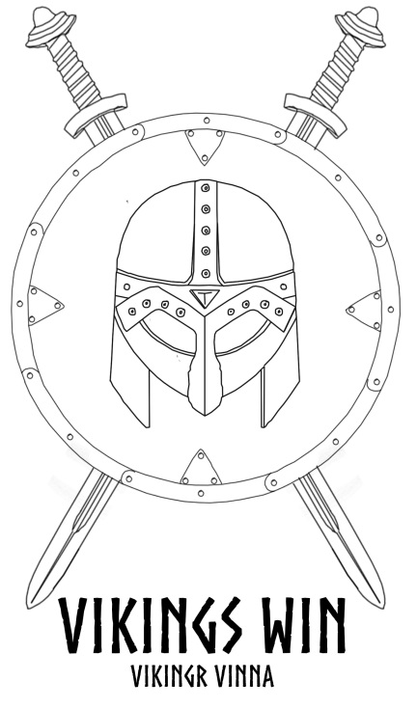
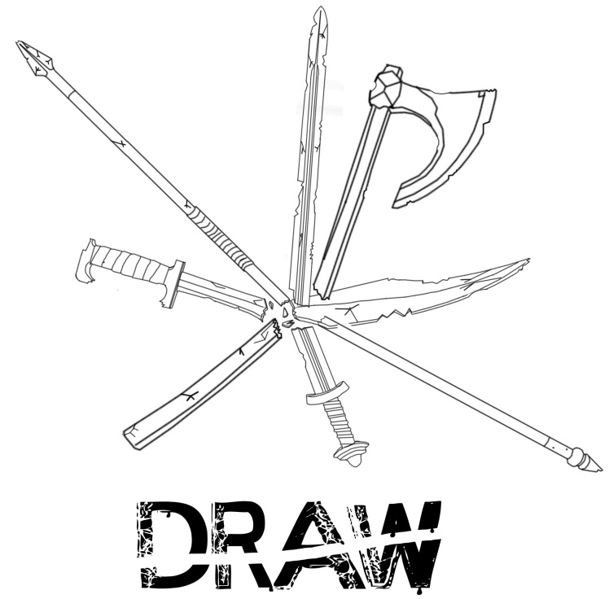
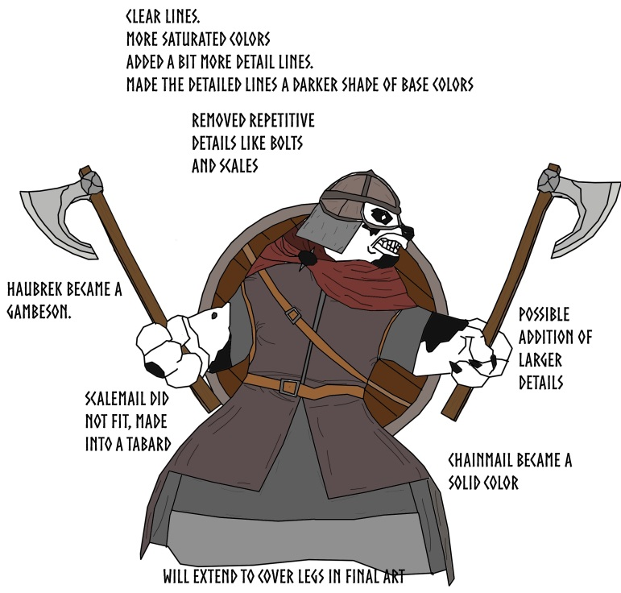
Concept Art
M&T
Notes:
Our first iterations on the background and main menu screens were dependent on those assets, and after using them to create an idea of the layout, we worked until we found a final solution. The next and most important part where we used them was in creating the game buttons, the main menu buttons and the victory and draw screens. Our last step in working on the concept art was iterating on the art style of our final product. There (4) we can see a clear idea of the changes we made in one of our iterations.

Slide 11
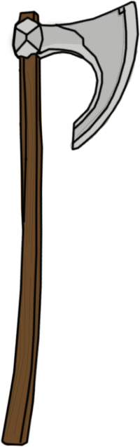
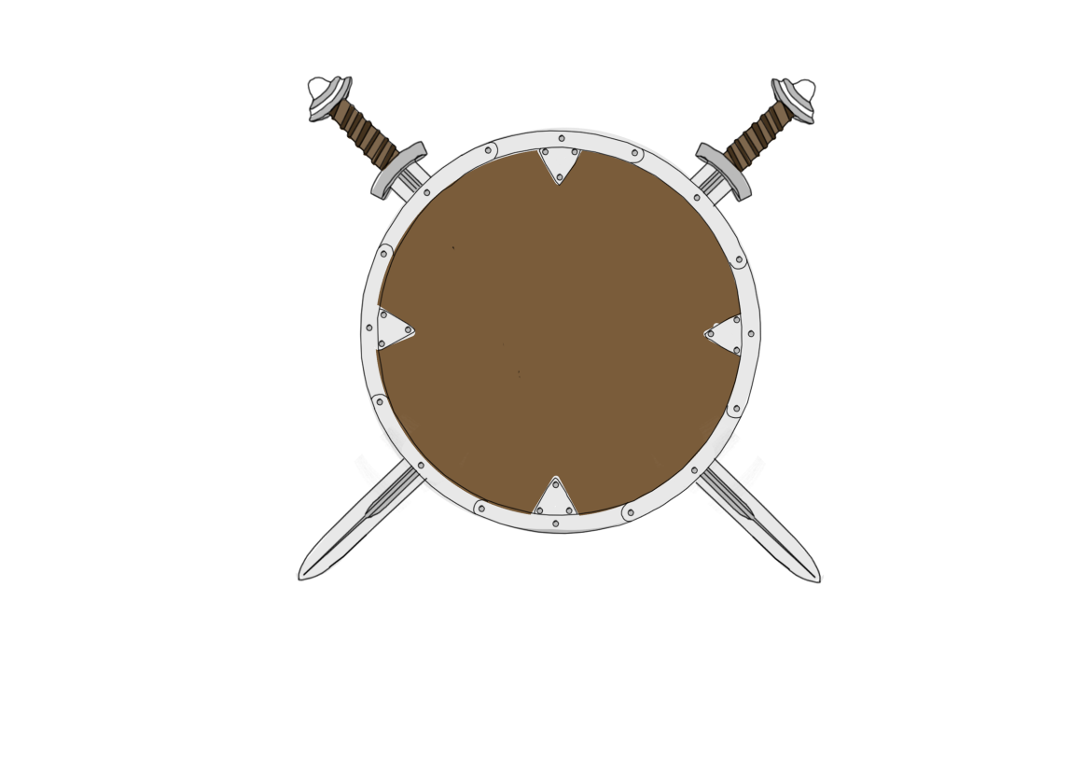
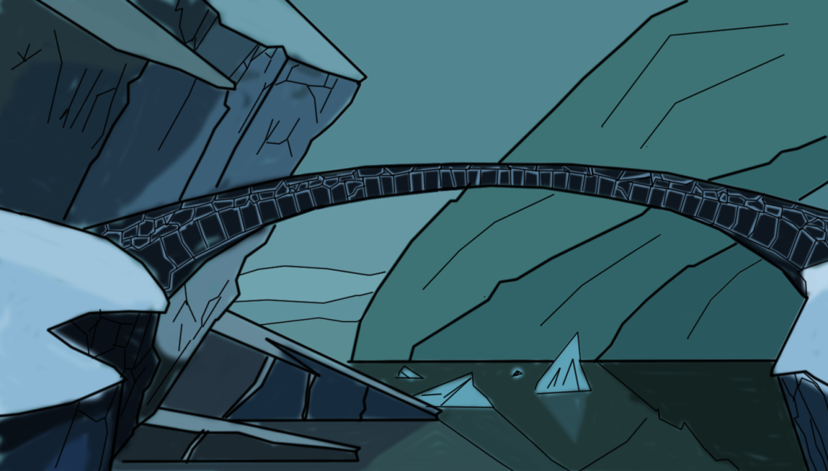
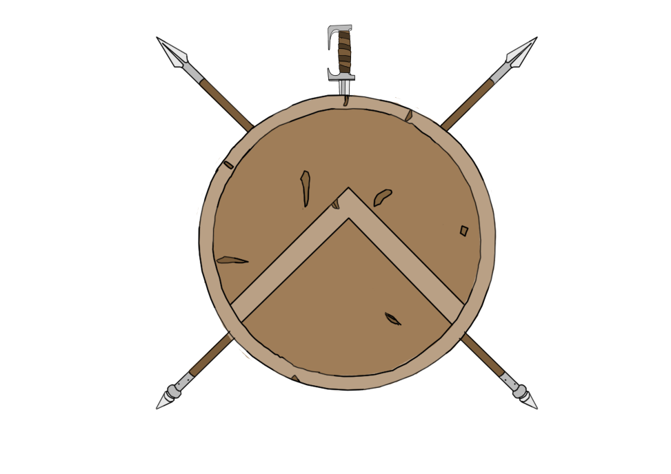
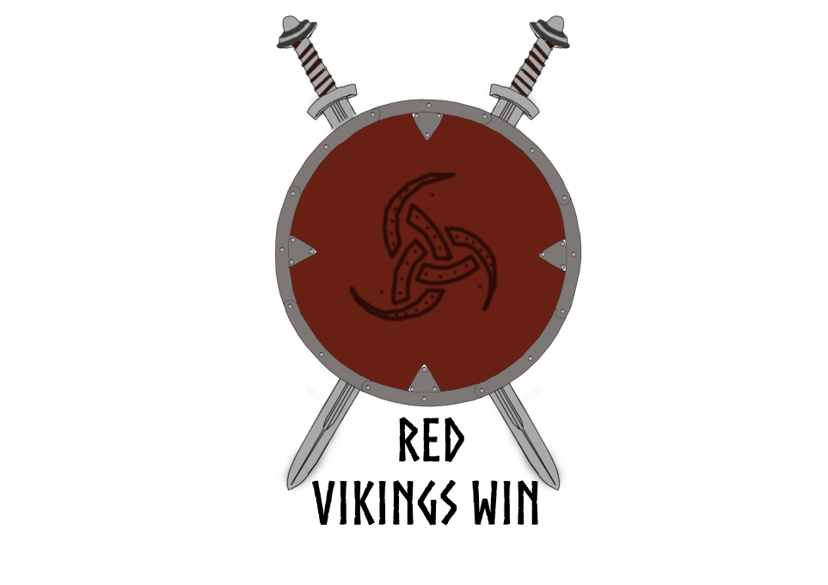
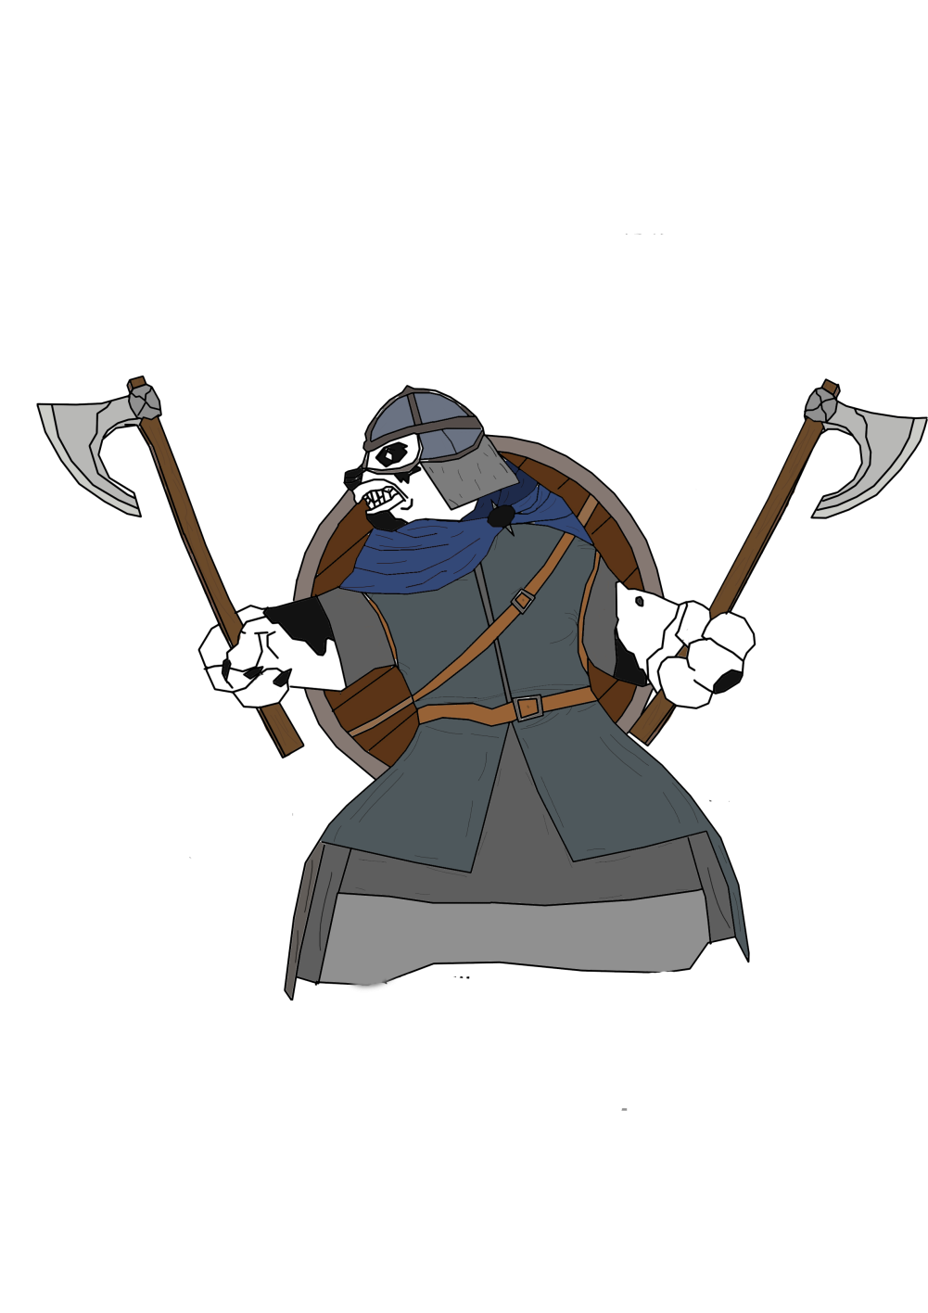
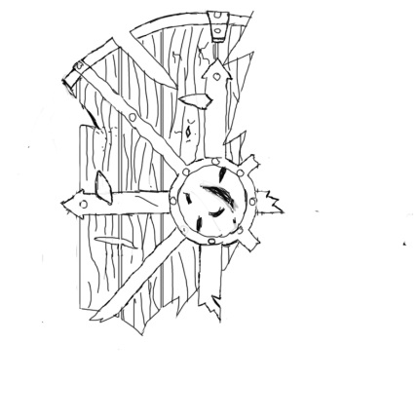
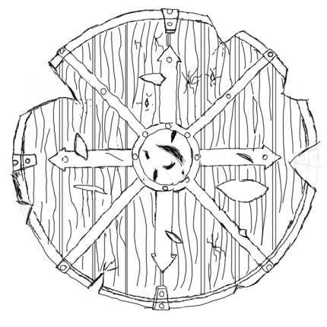
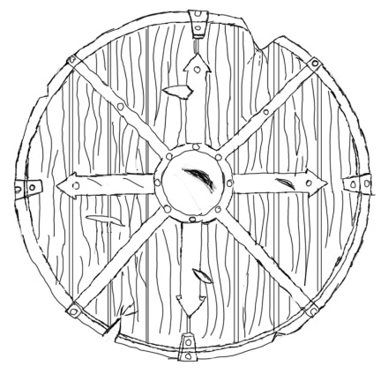
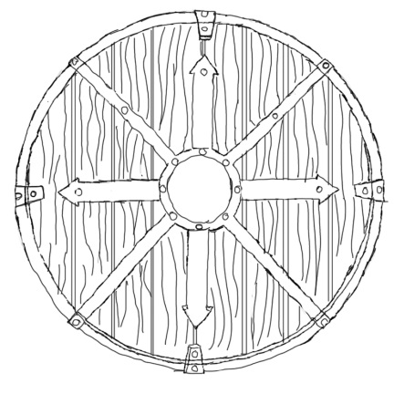
Current state of the art:
M&T
Health Display Iterations
Notes:
Here we see the state of the artwork we have for the current build. These are the latest uses and iterations of our assets in the “Armory” library, menu buttons, the attack button and one of the win screens we have. Next this is our current version of the “Player 2” character, the build lacking the Spartan side of the theme. And Finally, this is the next part of the concept art that we are going to transform into actual game assets and also work and give our actual assets a well needed finish and polish.

Slide 12
The following week
E
&
P
Improve the game based on player feedback
Refine game mechanics
Stretch goals:
Add the sound effects
Add animation
Notes:
Improve the prototype based on player feedback
Finish the art for the game

Slide 13
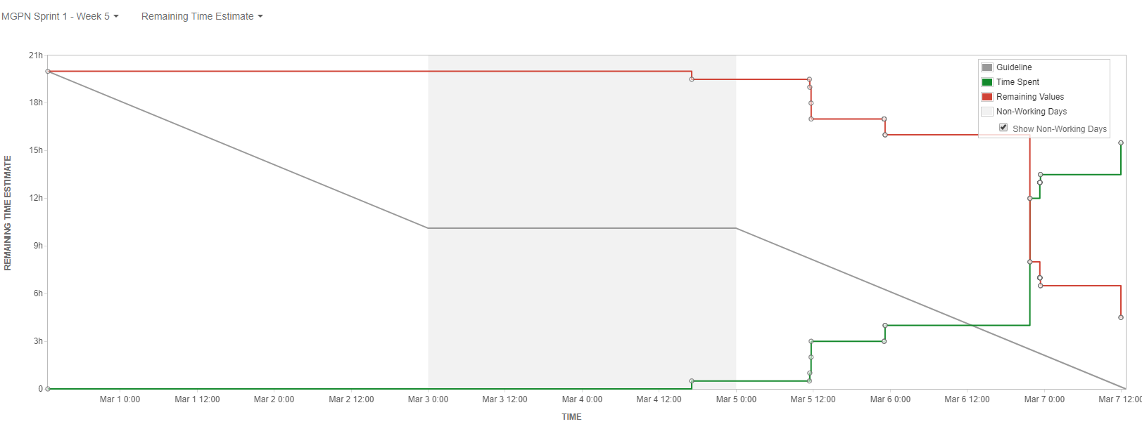
Management
Emails sent:
Ethan – 3, Toby – 2, Petrut – 1, Mircea – 4
Burn Down chart:

Slide 14
Any Questions?

